Slide 1


Slide 2
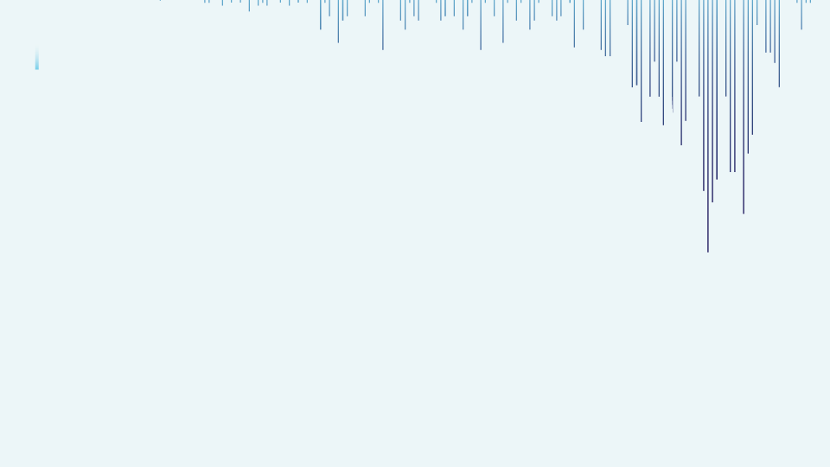


Walmart Sales Forecast
- Presented by Bhushan Koli

Slide 3
Information
My aim in this project is to build a Model which predicts sales of the stores. With this model, Walmart authorities can decide their future plans which is very important for arranging stocks, calculating revenue and deciding to make new investment or not.

Slide 4
Project Contents
Importing libraries
Loading and understanding the data​
EDA (Exploratory Data Analysis) and Preprocessing.
Train Test Split
Model building​
Decision Tree
Random forest ​
Feature Importance​

Slide 5
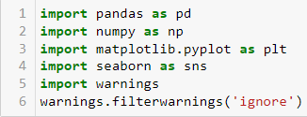
Importing Libraries
Pandas ​
Numpy​
Seaborn​
Matplotlib.pyplot

Slide 6
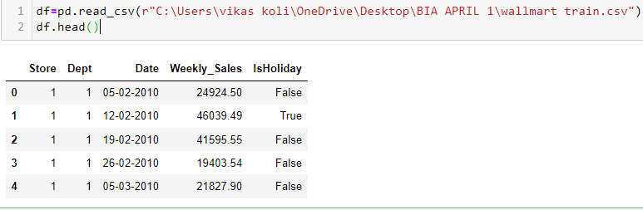
Loading data using pandas read_csv​

Slide 7
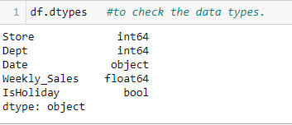

EDA (Exploratory Data Analysis) and Preprocessing

Slide 8
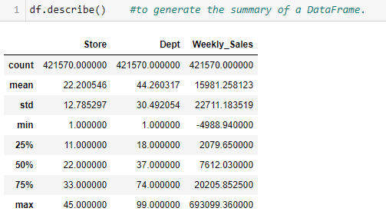
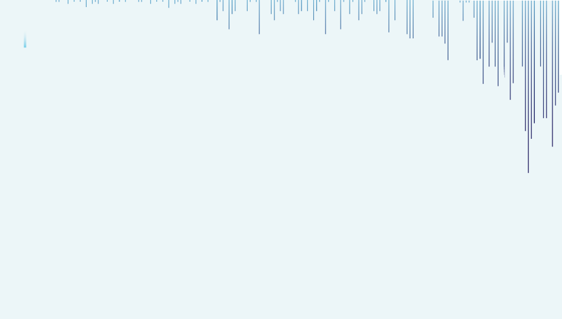

Slide 9
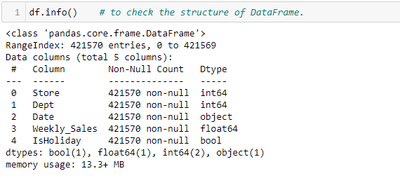
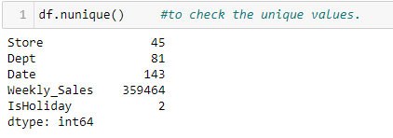

Slide 10
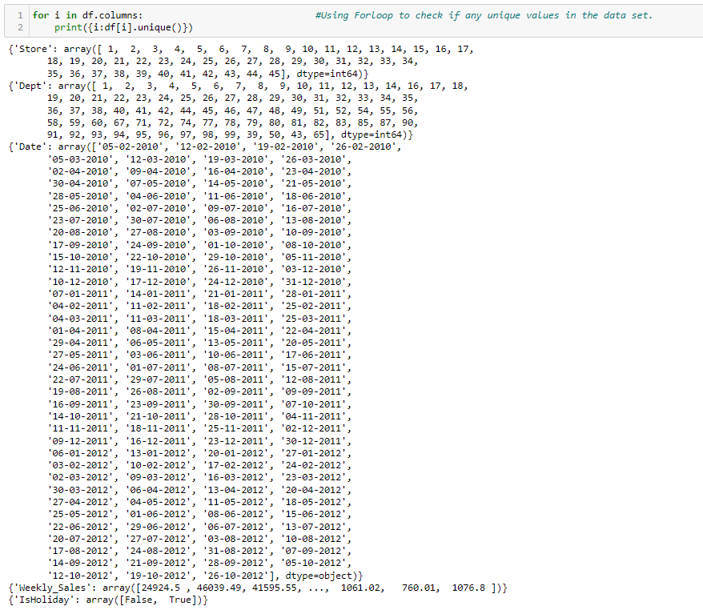

Slide 11
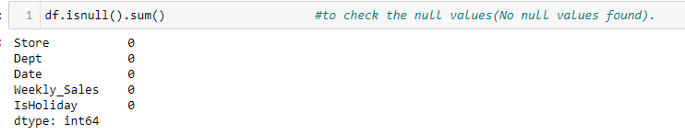
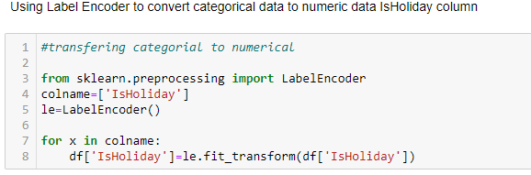

Slide 12
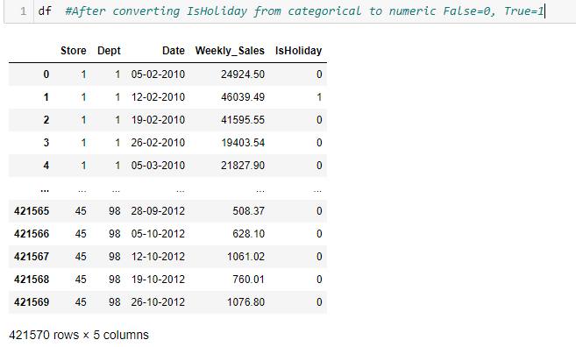
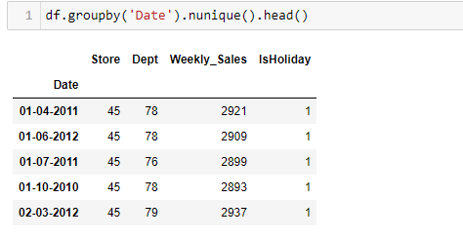

Slide 13
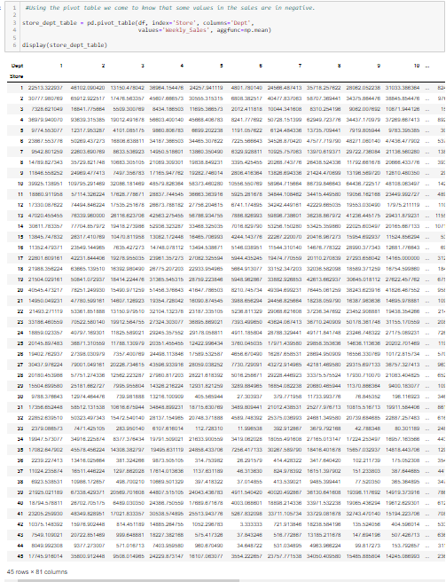

Slide 14
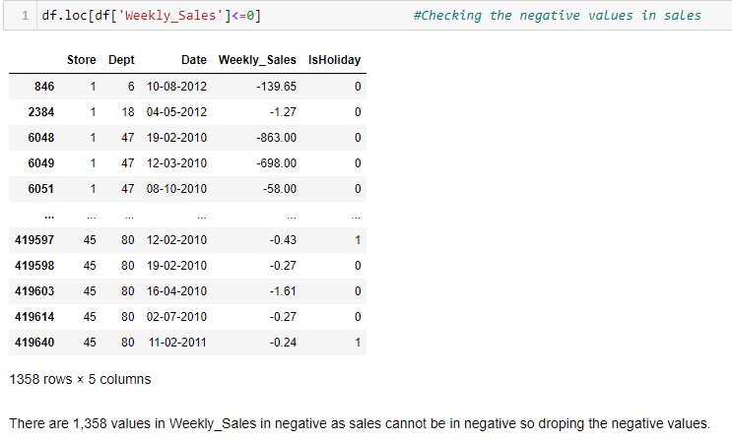

Slide 15



Slide 16
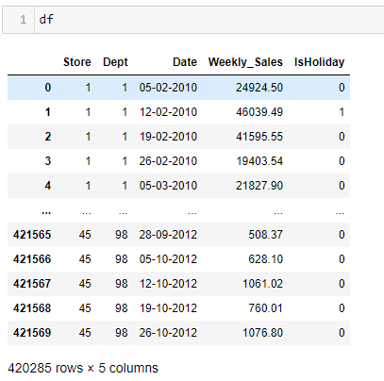

Slide 17
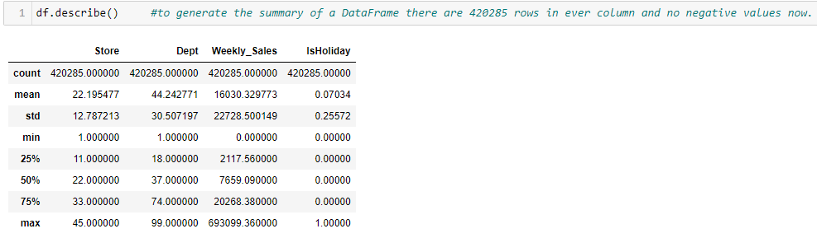

Slide 18
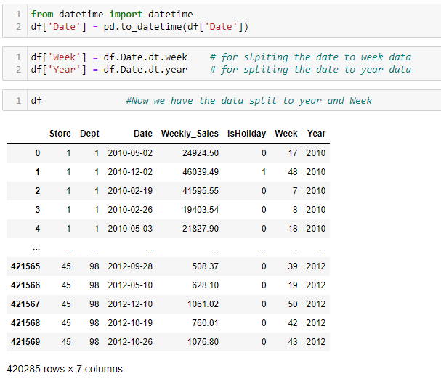
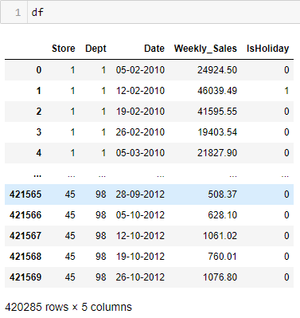

Slide 19
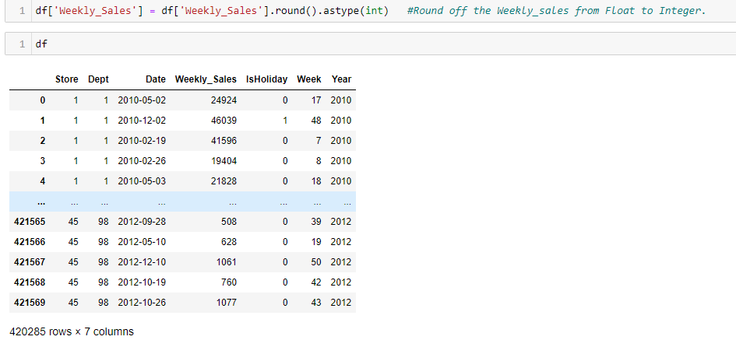
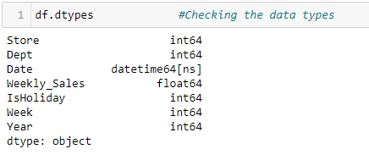

Slide 20
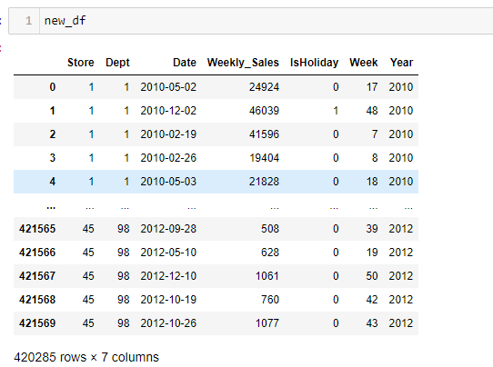
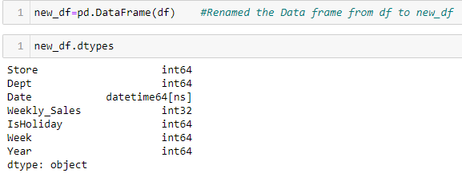

Slide 21
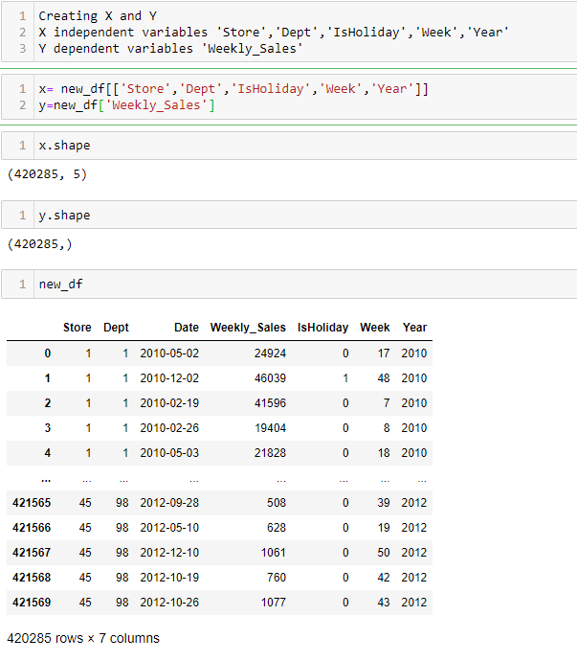

Slide 22
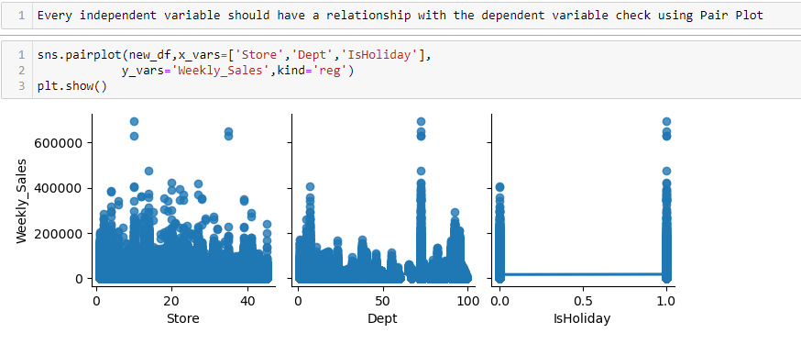

Slide 23
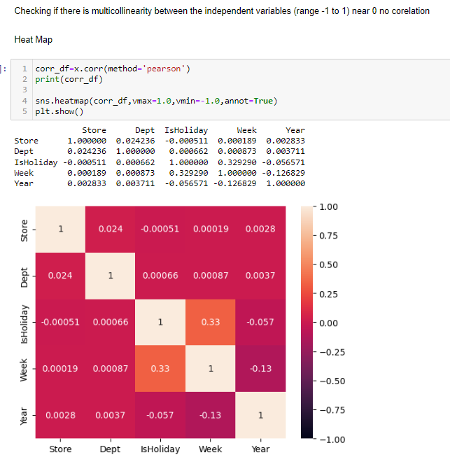

Slide 24
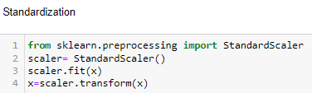

Slide 25
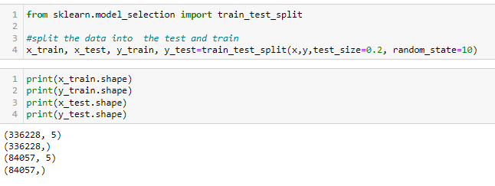
Train Test Split
Splitting the data in training and Testing 80% training and 20% testing.

Slide 26
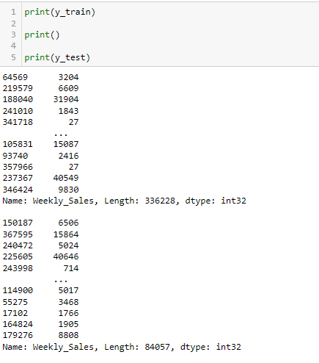
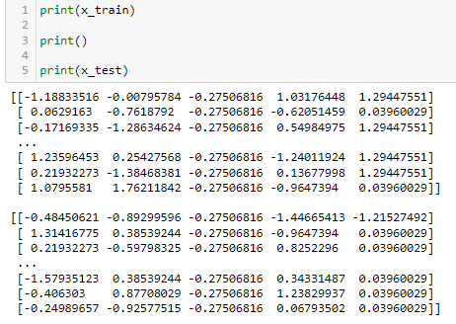

Slide 27
Model building
Due to the vast amount of data, we chose Decision Tree and Random Forest, which are powerful ensemble learning techniques that work best with Big Data.

Slide 28
Decision Tree Algorithm
A decision tree algorithm is a supervised machine learning technique used for both classification and regression tasks. It works on checking up the impurities based on Gini Index and Entropy which can be applied to a wide range of problems.

Slide 29
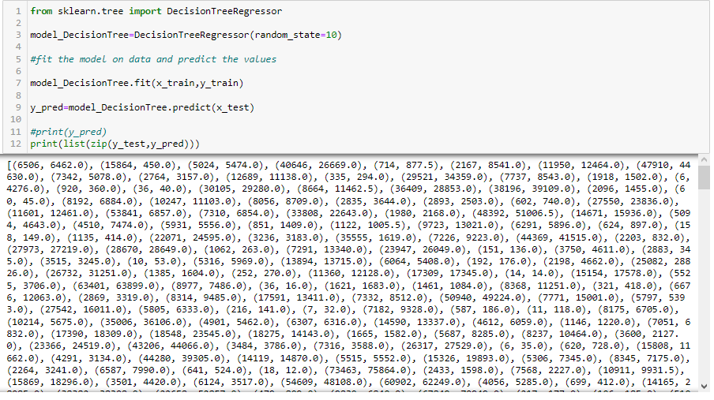

Slide 30
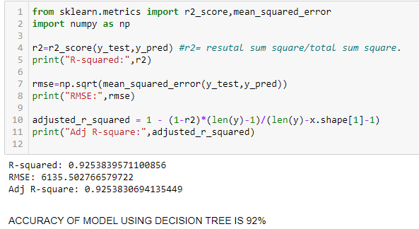
Accuracy Of Model Using Decision Tree Is 92%

Slide 31
Random Forest
Random Forest is a powerful ensemble learning algorithm used for classification and regression tasks. It's based on the concept of decision trees and combines multiple decision trees to make more accurate predictions.

Slide 32
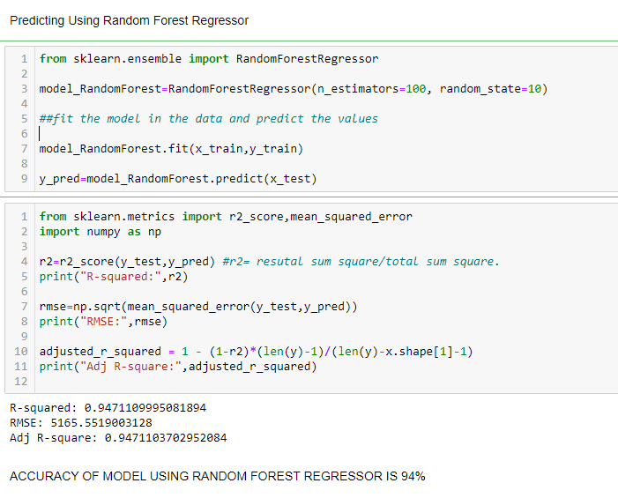
Accuracy Of Model Using
Random Forest Is 94%

Slide 33
Conclusion
Both the Decision Tree and Random Forest algorithms provide the best accuracy for the provided dataset of Walmart Sales Forecast. As Random Forest is an advanced Ensemble Learning Technique, and it provides the best accuracy of 94% with the low RMSE value as compared to Decision Tree. We will go with Random Forest Algorithm.

Slide 34

Thank you!!

